Slide 1

EE 216 Reconfigurable Computing
Topic 3 FPGA Architectures
Prof. Yajun Ha
ShanghaiTech University
Shanghai, China
Notes:
1

Slide 2

The 2nd Major FPGA Book to Read
Reconfigurable Computing: The Theory and Practice of FPGA-Based Computation,
By Scott Hauk and Andre Dehon, Morgan Kaufmann, 2008, ISBN-10: 0123705223

Slide 3
Reconfigurable Architectures
Coarse Grain Reconfigurable Architectures
FPGA Logic Blocks
FPGA Interconnects
Architecture Evaluation

Slide 4
Granularity of Reconfigurable Architectures
Functional Block
Functional blocks are built by LUTs or ALUs?
Wires are organized by individually or by bus or channels?
Routing Network
I/O Block
Notes:
What are the major factors to be considered for the design of an embedded SoC?
The most important factor is TTM. In other words, you must design and sell it faster than others or you lose. I’ll explain this in the following slides.
The technology advances rapidly and there are lots of challenges.
Leveraging on the advances in the technology, we must be able to satisfy the ever-increasing performance need.
Power consumption is another important issue.
Reliability, ...
Cost is still an important issue. Chip area is the most concern in our case.

Slide 5
Reconfigurable Architecture Space
Fine Grain Reconfigurable Architectures (FPGA)
Array of bit level function blocks (LUTs)
Implement bit manipulation tasks without wasting resources
Numerous PEs to implement a basic computation
Slower clock rate and larger area to implement word-level computations
Coarse Grain Reconfigurable Architectures
Array of coarse grain ALU or multipliers
Interconnects are coarse grain as well, e.g., bus based.
Not suitable for bit level operations.
Compilers are hard to develop as multi-core processors.

Slide 6
Coarse Grain RA
rDPA: reconfigurable Data Path Array
Function Units with programmable interconnects
ALU
ALU
ALU
ALU
ALU
ALU
ALU
ALU
ALU

Slide 7
Coarse Grain RA
rDPA: reconfigurable Data Path Array
Function Units with programmable interconnects
ALU
ALU
ALU
ALU
ALU
ALU
ALU
ALU
ALU

Slide 8
Example: PipeRench
Coarse granularity
Higher level programming
Reference papers
PipeRench: A Coprocessor for Streaming Multimedia Acceleration (ISCA 1999): http://www.cs.cmu.edu/~mihaib/research/isca99.pdf
PipeRench Implementation of the Instruction Path Coprocessor (Micro 2000): http://class.ee.iastate.edu/cpre583/papers/piperench_Micro_2000.pdf

Slide 9
Example: PipeRench
PE
PE
PE
8-bit ALU
8-bit ALU
8-bit ALU
Reg file
Reg file
Reg file
Interconnect
PE
PE
PE
Global bus
8-bit ALU
8-bit ALU
8-bit ALU
Reg file
Reg file
Reg file
Interconnect
PE
PE
PE
8-bit ALU
8-bit ALU
8-bit ALU
Reg file
Reg file
Reg file

Slide 10
Reconfigurable Architectures
Coarse Grain Reconfigurable Architectures
FPGA Logic Blocks
FPGA Interconnects
Architecture Evaluation

Slide 11
FPGA Logic Blocks
CLB
CLB
CLB
CLB
CLB
CLB
CLB
CLB
Configurable Logic Block
CLB
CLB
CLB
CLB
CLB
CLB
CLB
CLB

Slide 12
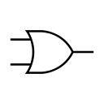



FPGA Functional Blocks
CLB
CLB
CLB
CLB
CLB
CLB
CLB
Configurable Logic Block
CLB
CLB
CLB
CLB
CLB
CLB
CLB
CLB

Slide 13
FPGA Logic Blocks
CLB
CLB
CLB
Configurable Logic Block
CLB
CLB
CLB
CLB
CLB

Slide 14
Computational Fabric - LUT
Z
LUT = Look up Table
A
4-LUT
B
C
D
ABCD Z
X000
X001
X010
X101
X110
X111
0
1
0
0
1
1
ABCD Z
ABCD Z
ABCD Z
0000
0001
1110
1111
0000
0001
1110
1111
0
0
0
1
0000
0001
1110
1111
0
1
1
1
B
A
A
Z
B
AND
Z
B
OR
Z
C
2:1
Mux
1
0
C
C
D
D
D

Slide 15
Computational Fabric - LUT
Z
LUT = Look up Table
A
4-LUT
B
C
D
How many 4-LUTs needed
to OR 32-bits
4 LUT
4
LUT
4 LUT
32
4 LUT
4
LUT
4 LUT
1
4 LUT
4
LUT
4 LUT
4 LUT
4 LUT

Slide 16
Computational Fabric - LUT
Z
A
4-LUT
LUT = Look up Table
B
C
D
How many 4-LUTs needed
to AND 2-bits with the 32-bit OR
4 LUT
4
LUT
4 LUT
32
4 LUT
4
LUT
4 LUT
1
4 LUT
4
LUT
4 LUT
4 LUT
4 LUT

Slide 17
Computational Fabric - LUT
Z
LUT = Look up Table
A
4-LUT
B
C
D
How could one build a 4-LUT?
ABCD
4
1x16
Memory
0
0
0
0
0
1
16:1
Mux
Z

Slide 18
Computational Fabric - LUT
Z
A
4-LUT
LUT = Look up Table
B
C
D
How many different 4 input functions can a 4-LUT implement?
ABCD
4
2¹⁶ = 65536
1x16
Memory
0
0
0
0
0
1
16:1
Mux
Z

Slide 19
Computational Fabric - LUT
Z
LUT = Look up Table
A
4-LUT
B
C
D
How many different N input functions can a N-LUT implement?
ABCD
N
= 2^{2N}
1x2^{N}
Memory
N = 4
0
0
0
0
0
1
2¹⁶ =2²⁴=65536
16:1
Mux
Z

Slide 20
Computational Fabric - DFF
Z
A
4-LUT
B
C
D
LUTs are fine for implementing any arbitrary combinational logic (output is ONLY a function of its inputs) function. But what about sequential logic (output is a function of input AND previous state information)?
Need Memory!!!

Slide 21
Computational Fabric - DFF
Z(t)
A
4-LUT
B
Z(t+1)
C
DFF
D
DFF = D Flip Flop
Detect the pattern “1101”
1/0
1/0
0/0
Input/output
1
11
110
1101
1/1
0/0
0/0
1/0
Start

Slide 22
Computational Fabric - DFF
Z(t)
A
4-LUT
B
Z(t+1)
C
DFF
D
DFF = D Flip Flop
Increase circuit performance (pipelining)
A
4 LUT delays
per output
4-LUT
4-LUT
4-LUT
4-LUT
B
C
DFF
DFF
DFF
DFF
D
1 DFF delay
per output
A
4-LUT
4-LUT
4-LUT
4-LUT
B
C
DFF
DFF
DFF
DFF
D

Slide 23
One Logic Element
F
Z(t)
A
4-LUT
B
Z(t+1)
C
DFF
D

Slide 24
FPGA Functional Block
Local
Inter-
connect
LE
Functional Block
Inputs
Functional Block
Outputs
LE
…..
LE
Functional Block Internals
FPGAs use the Look-Up Table (LUT) type of functional block. Such a functional block is normally made of one or several logic elements (LE). They differentiate from each other mainly in terms of the input size of a LE and the number of LEs in a functional block. State-of-the-art FPGAs normally use 4-input LEs.

Slide 25
Simplified FPGA Architecture
Functional Block
All the three FPGA components can be re-programmed with configurations to implement application-specific digital circuits.
For example, each functional block can be programmed to implement a small amount of digital logic of a design; the routing network can be programmed to implement the design specific interconnection pattern; I/O blocks can be programmed to implement the input and output ports according to design requirements.
Routing Network
I/O Block
Notes:
What are the major factors to be considered for the design of an embedded SoC?
The most important factor is TTM. In other words, you must design and sell it faster than others or you lose. I’ll explain this in the following slides.
The technology advances rapidly and there are lots of challenges.
Leveraging on the advances in the technology, we must be able to satisfy the ever-increasing performance need.
Power consumption is another important issue.
Reliability, ...
Cost is still an important issue. Chip area is the most concern in our case.

Slide 26
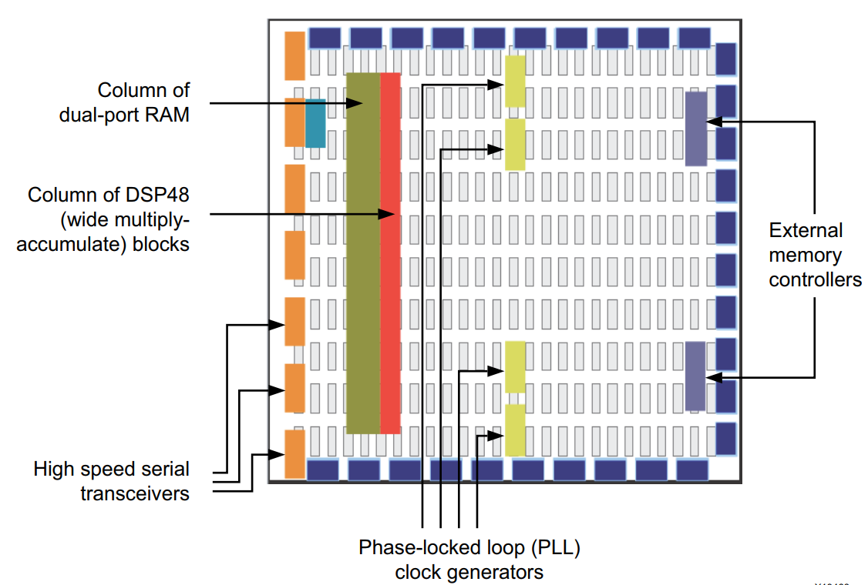
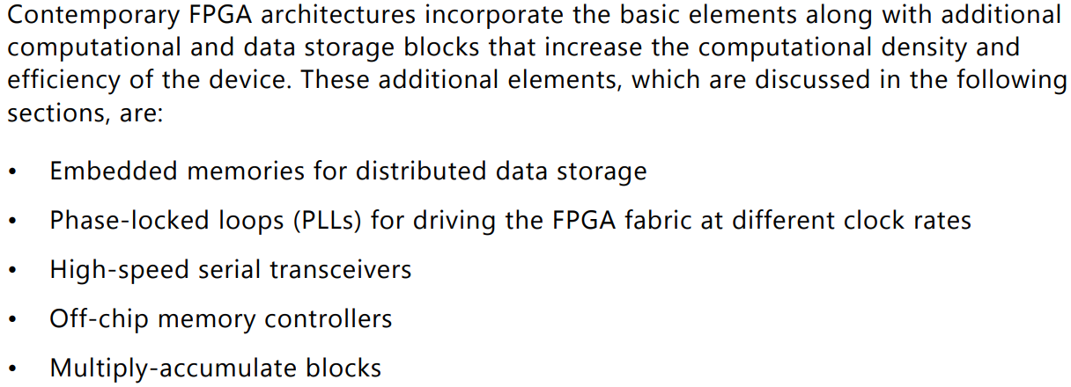
Contemporary FPGA Architecture
Notes:
What are the major factors to be considered for the design of an embedded SoC?
The most important factor is TTM. In other words, you must design and sell it faster than others or you lose. I’ll explain this in the following slides.
The technology advances rapidly and there are lots of challenges.
Leveraging on the advances in the technology, we must be able to satisfy the ever-increasing performance need.
Power consumption is another important issue.
Reliability, ...
Cost is still an important issue. Chip area is the most concern in our case.

Slide 27
Optimized Resources: Dedicated Logic
LUTs + DFFs can implement any arbitrary digital
logic. But not optimally (ASICs give make much
better use of silicon area for Power, Speed, routing
resources)
Arithmetic
Add, Multiply
On chip memory
System on chip building blocks
Processor, PCI-express, Gigabit Ethernet, ADC, etc.

Slide 28
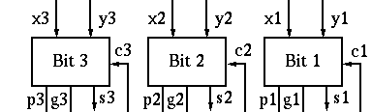
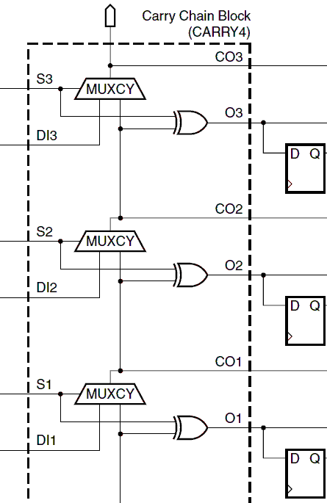
Optimized Resources: Dedicated Logic
Fast Addition
generate propagate
logic
Carry out
Two output LUT
A₃
6-LUT
c4
Carry Look Ahead
B₃
Sum 3
A₂
B₂
A₁
A₂
6-LUT
B₁
P1
CLB
P2
Carry₁
B₂
Sum 2
A₁
B₁
G1
Carry
2
G2
Carry₁
A₁
6-LUT
A₁
B₁
Sum
1
CLB
Sum
2
B₁
Sum 1
Carry₁
Dedicated routing
resources
Carry in

Slide 29
Optimized Resources: Dedicated Logic
Embedded Memory
8
18 Kbits, 550 MHz
Dedicated memory block
12

Slide 30
Optimized Resources: Dedicated Logic
Multiplication
18x18 multiply
Type | # LUTs | Latency | Speed
LUT | ~400 | 5 clks | 380 MHz
Dedicated 18x18 Multiplier | 0 | 3 clks | 450 MHz
Virtex-5 (6-LUTs)
Very rough estimate of Silicon area comparison
(assuming SX95 andLX110 have about the same die size)
6-LUT
6-LUT
18x18
Multiplier
In other word you can replace
one LUT-based 18x18 multiplier
With 100 dedicated 18x18
Multipliers!!!
6-LUT
6-LUT

Slide 31
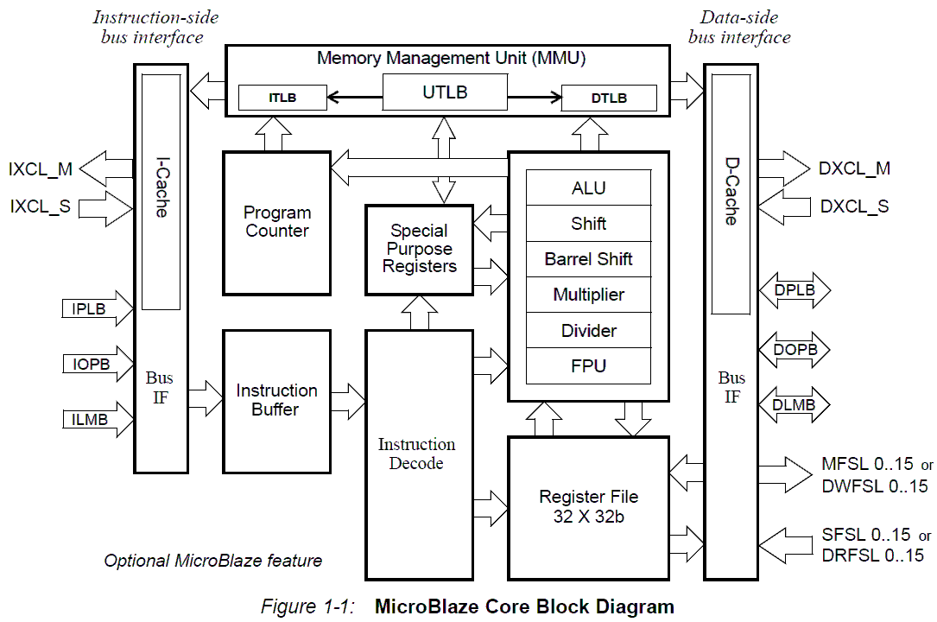
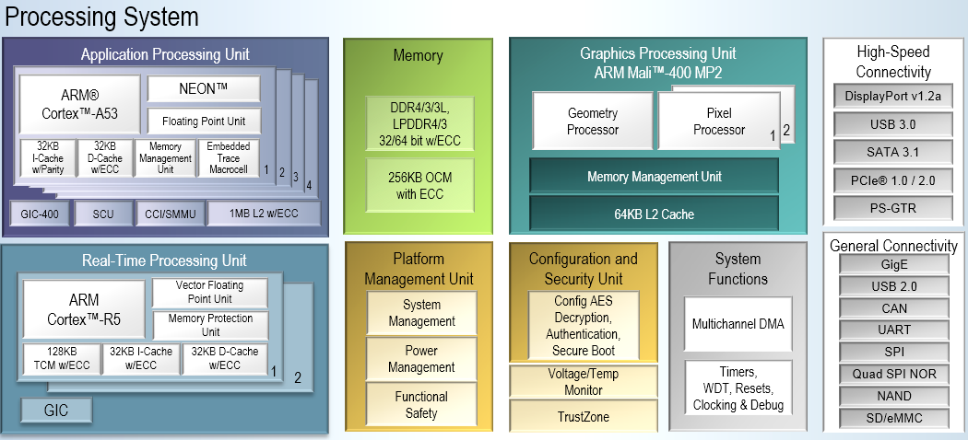
Optimized Resources: Dedicated Logic
Processors
ARM hard-core
MicroBlaze soft-core
Quad A53 cores
Clock up to 1.5G
Superscalar
Zynq UltraScale EV
250 MHz
Simple scalar

Slide 32
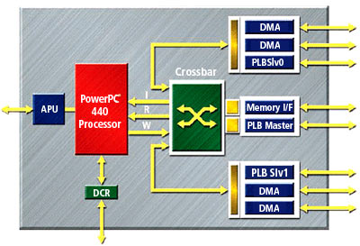
Optimized Resources: Dedicated Logic
System on Chip
Dedicated Logic
Reconfigurable Logic
RAM
ADC
Sensor
Matrix Multiplier
Coprocessor
Sensor
Motor
Data
Buffer
PID
Controller
Ethernet
MAC
Also see Actel Fusion:http://www.actel.com/products/fusion/default.aspx

Slide 33
Reconfigurable Architectures
Coarse Grain Reconfigurable Architectures
FPGA Logic Blocks
FPGA Interconnects
Architecture Evaluation Metrics and Models

Slide 34
FPGA Interconnect
Logics and Interconnects are un-balanced in FPGAs.
Qualitatively:
“PLDs are 90% routing and 10% logic.”
Prof. Jonathan Rose, Design of Interconnection Networks for Programmable Logic, Kluwer Academic Publishers, 2004, Page xix;
“…(in FPGAs) programmable interconnect comes at a substantial cost in area, performance and power.”
Prof. Jan Rabaey, Digital Integrated Circuits, 2nd Edition, Prentice-Hall, 2003, Page 413;
Quantitatively:
Area: Logic area v.s. Routing area;
Delay: Logic delay v.s. Net delay;
Power: Dynamic power consumption by Logic v.s. by Interconnect.

Slide 35
Unbalance: Area
Relative weight of routing area and logic area of the 20 largest MCNC benchmark circuits, assuming PTM 90nm CMOS process. Data produced by VPR v5.0.2.

Slide 36
Unbalance: Delay
Delay breakdown along the critical path for the 20 largest MCNC benchmarks,
assuming PTM 90nm CMOS process. Data produced by VPR v5.0.2.
36

Slide 37
Unbalance: Power
Note:
Double: The length-2 wires;
Hex: The length-6 wires;
Long: The long wires spanning the whole
chip;
IXbar & OXbar: Crossbar at the input &
output pins of the logic blocks.
Dynamic power breakdown for a real circuit [1], assuming the Xilinx Virtex-II FPGAs
[1] L. Shang, A. Kaviani and K. Bathala, “Dynamic power consumption in Virtex-II FPGA family,” ACM FPGA, 2002.

Slide 38
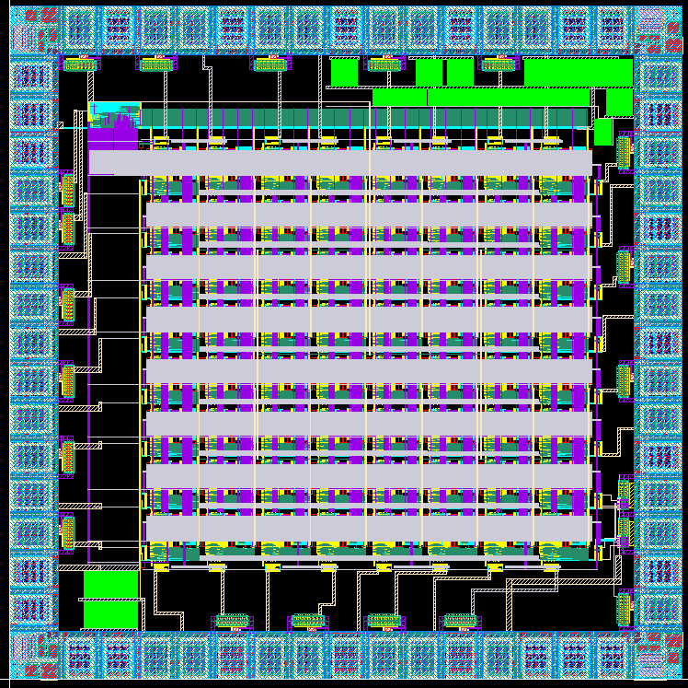
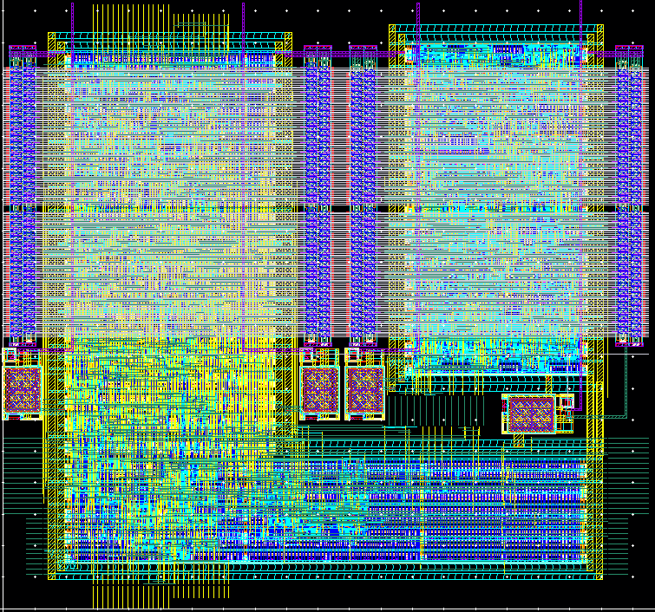
A Home-Made FPGA Layout
Programming Circuitry
8X8 Tiles
Routing Resources
SB+CB
Four 4-input LUTs
1mm
100um
1mm
SRAM
CLB &
Local MUX
Switch Box & Connection Box
100um

Slide 39
Communication: Interconnect & Routing
Need a mechanism to move results of computation around.
CLB
CLB
CLB
CLB
CLB
CLB
CLB
CLB
CLB
CLB
CLB
CLB
CLB
CLB
CLB
CLB
CLB
CLB
CLB
CLB
CLB
CLB
CLB
CLB
CLB
CLB
CLB
CLB
CLB
CLB
CLB
CLB
CLB
CLB
CLB
CLB

Slide 40
Communication: Interconnect & Routing
CLB
CLB
CLB
CLB
CLB
CLB
CLB
CLB
CLB
CLB
CLB
CLB
CLB
CLB
CLB
CLB
CLB
CLB
Nearest Neighbor:
CLB
CLB
CLB
CLB
CLB
CLB
CLB
CLB
CLB
CLB
CLB
CLB
CLB
CLB
CLB
CLB
CLB
CLB

Slide 41
Communication: Interconnect & Routing
CLB
CLB
CLB
CLB
CLB
CLB
Nearest Neighbor:
CLB
CLB
CLB
CLB
CLB
CLB
Segmented:
CLB
CLB
CLB
CLB
CLB
CLB
CLB
CLB
CLB
CLB
CLB
CLB
CLB
CLB
CLB
CLB
CLB
CLB
CLB
CLB
CLB
CLB
CLB
CLB

Slide 42
Communication: Interconnect & Routing
Nearest Neighbor:
CLB
CLB
CLB
CLB
CLB
CLB
CLB
CLB
CLB
CLB
CLB
CLB
Segmented:
CLB
CLB
CLB
CLB
CLB
CLB
CLB
CLB
CLB
CLB
CLB
CLB
Hierarchical:
CLB
CLB
CLB
CLB
CLB
CLB
CLB
CLB
CLB
CLB
CLB
CLB

Slide 43
NoC-Based FPGA Interconnects
FPGA
Tile
FPGA
Tile
FPGA
Tile
FPGA
Tile
NoC
FPGA
Tile
FPGA
Tile
The wires required for NoC based FPGA are close to be linear to the array size.
We (hardware engineers) know programming multi-FPGA more than programming multi-core processors.

Slide 44
Reconfigurable Architectures
Coarse Grain Reconfigurable Architectures
FPGA Logic Blocks
FPGA Interconnects
Architecture Evaluation

Slide 45
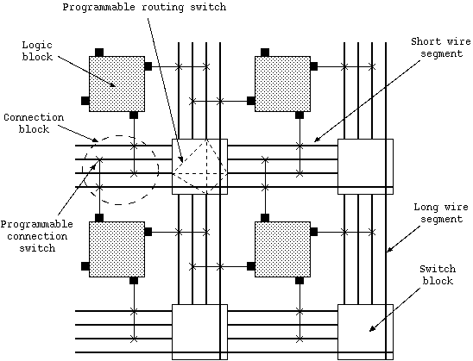
FPGA Architecture Description
Functional Block
An FPGA architecture can be described with high level parameters such as array size, switch block type, etc., in a file called x.arch.

Slide 46
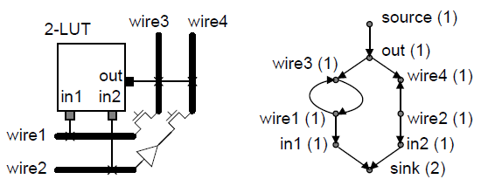
Routing-Resource Graph (RRG)
Directed graph G(V,E), representing routing resources and their connections.
V: CLB pins and wires. Each node can be associated with capacity, occupancy, and delay, etc.
E: Switches. Each edge can be associated with delay, etc.
Routing tree RTi embedded in G(V,E) fully specifies a net's routing path.
46
Notes:
46

Slide 47
FPGA Architecture and EDA Exploration Framework
FPGA Architecture File (.arch; .xml)
Placement & Routing
Placement & routing Results (.net)

Slide 48
VPR Architecture and EDA Exploration Framework
VPR: Versatile Placement and Routing
http://www.eecg.toronto.edu/~vaughn/vpr/vpr.html

Slide 49
FPGA Verilog-to-Routing Project Experiment Flow
Experiment Flow:
Tech mapping (ABC)
Packing using (T-Pack)
Cluster activity estimation (Odin-2)
P&R (VPR)
Power estimation using KPM [15]
Overestimates, but produces results with good fidelity
HSPICE simulation delays and model parameters annotated into VPR architecture XML file for delay and power modeling
Benchmark: MCNC suite
Please refer to Verilog-to-Routing project page
http://code.google.com/p/vtr-verilog-to-routing/
Notes:
49

Slide 50
Reconfigurable Architecture Research Topics
Logic Blocks
Use non-LUT type of logic blocks in FPGAs
Cluster with logic blocks in a way to reduce wiring requirements
Interconnect Networks
Various ways to organize FPGA wires efficiently
Switch box design to use minimum area to provide maximum flexibility
Low Power
Dual Vdd, Dual Vt to reduce leakage power
Apply power gating to FPGAs
Fault Tolerance and Emerging Technologies for FPGA Architectures

Slide 51
Reading List This Week
Rethinking FPGAs: Elude the Flexibility Excess of LUTs with And-Inverter Cones, FPGA 2012, Feb, 2012. (propose not to use LUTs but other basic blocks in FPGAs)
Analysis and Evaluation of a Hybrid Interconnect Structure for FPGAs, ICCAD 2007. (propose a hybrid interconnect structure to provide the scalability for FPGA wires)
Defect-Tolerant FPGA Architecture Exploration, FPL 06. (propose a family of defect-tolerant FPGA architectures)
Assignment: Find 3 recent (in the past 3 years) papers on FPGA architecture research and write in one page for each paper of their identified problems and their solutions. Due in Mar 30, 2022.
Notes:
51

